Slide 1
Azure Solution Expert
By- Vinay Middha
06/24/2023

Slide 2


Module -1 Design governance
06/25/2023

Slide 3

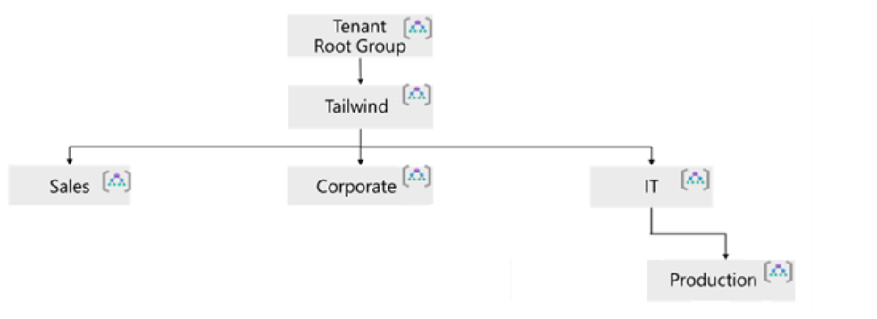
Management Groups
Management groups are containers that help you manage access, policy, and compliance across multiple subscriptions. You can use management groups to:
Limit the regions where virtual machines can be created, across subscriptions.
Provide user access to multiple subscriptions by creating one role assignment that's inherited by other subscriptions.
Monitor and audit role and policy assignments, across subscriptions.
Things to consider when creating management groups
Design management groups with governance in mind
Keep the management group hierarchy reasonably flat
Consider a top-level management group
Consider an organizational or departmental structure
Consider a geographical structure
Consider a production management group.
Consider isolating sensitive information in a separate management group

Slide 4

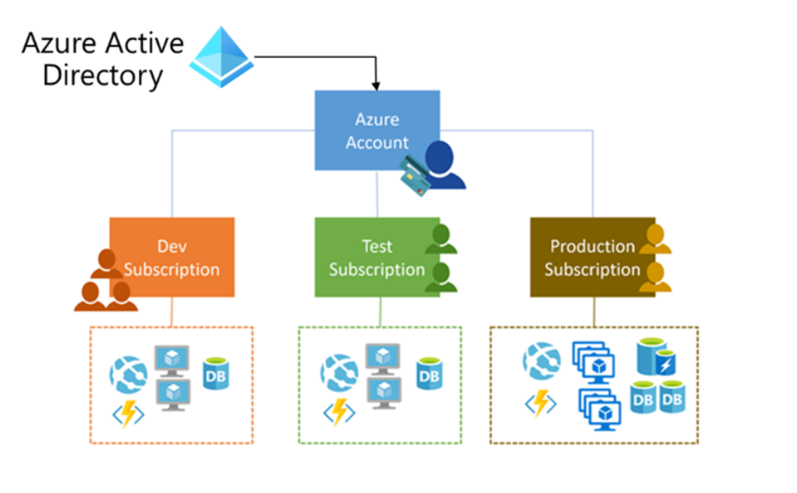
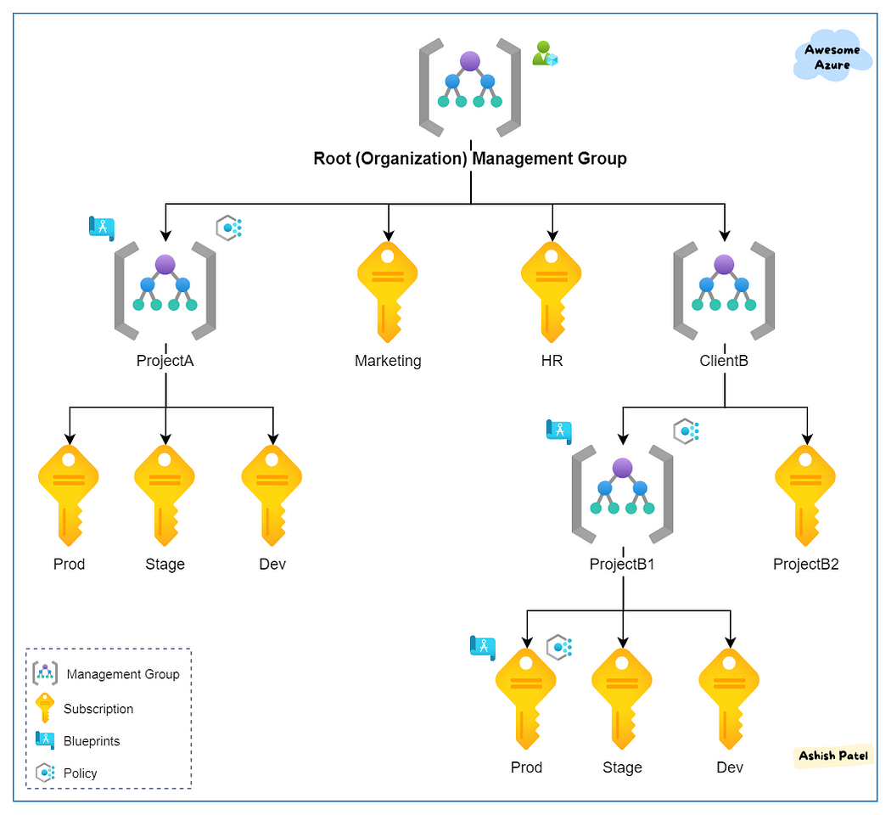
Subscription
Azure Subscriptions are logical containers that serve as units of management and scale and billing boundaries. Limits and quotas can be applied, and each organization can use subscriptions to manage costs and resources by group.
Subscriptions can provide separate billing environments, such as development, test, and production.
Policies for individual subscriptions can help satisfy different compliance standards.
You can organize specialized workloads to scale beyond the limits of an existing subscription.
By using subscriptions, you can manage and track costs for your organizational structure.
Things to consider when creating management groups
Group subscriptions together under management
Consider a dedicated shared services subscription
Consider subscription scale limits
Consider administrative management.
Consider how to assign Azure policies
Consider making subscription owners aware of their roles and responsibilities

Slide 5

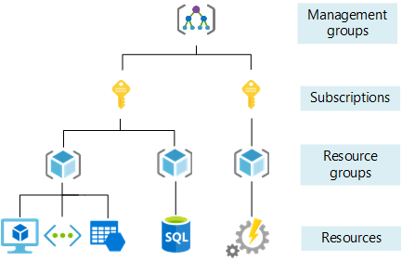
Resource Group
Resource groups are logical containers into which Azure resources are deployed and managed.​ These resources can include web apps, databases, and storage accounts. You can use resource groups to:
Place resources of similar usage, type, or location in logical groups.
Organize resources by life cycle so all the resources can be created or deleted at the same time.
Apply role permissions to a group of resources or give a group access to administer a group of resources.
Use resource locks to protect individual resources from deletion or change.
Resource groups have their own location (region) assigned. This region is where the metadata is stored.
If the resource group's region is temporarily unavailable, you can't update resources in the resource group because the metadata is unavailable. The resources in other regions still function as expected, but you can't update them.
Resources in the resource group can be in different regions.
A resource can connect to resources in other resource groups. You can have a web application that connects to a database in a different resource group.
Resources can be moved between resource groups with some exceptions.
You can add a resource to or remove a resource from a resource group at any time.
Resource groups can't be nested.
Each resource must be in one, and only one, resource group.
Resource groups can't be renamed.

Slide 6

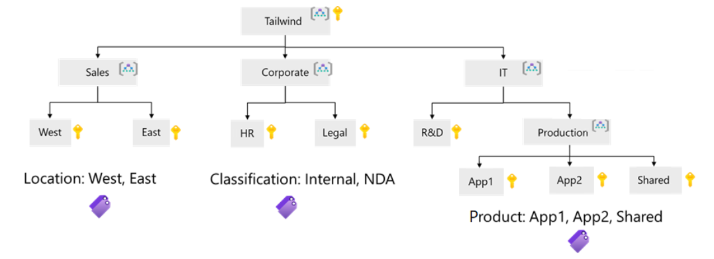
Resource Tags
Resource tags are another way to organize resources. Tags provide extra information, or metadata, about your resources.
A resource tag consists of a name-value pair. For example, env = production or env = dev, test.
You can assign one or more tags to each Azure resource, resource group, or subscription.
Resource tags can be added, modified, and deleted. These actions can be done with PowerShell, the Azure CLI, Azure Resource Manager (ARM) templates, the REST API, or the Azure portal.
Tags can be applied to a resource group. However, tags applied to a resource group aren't inherited by the resources in the group.
Things to consider when creating resource tags
Consider whether you need IT-aligned or business-aligned tagging
Consider using Azure policy to apply tags and enforce tagging rules and conventions
Consider the type of tagging required.
Functional - app = catalogsearch1, tier = web, webserver = Apache, env=Production, dev, staging
Classification - confidentiality = private, SLA = 24hours
Accounting - department = finance, program = business-initiative , region = north-America

Slide 7

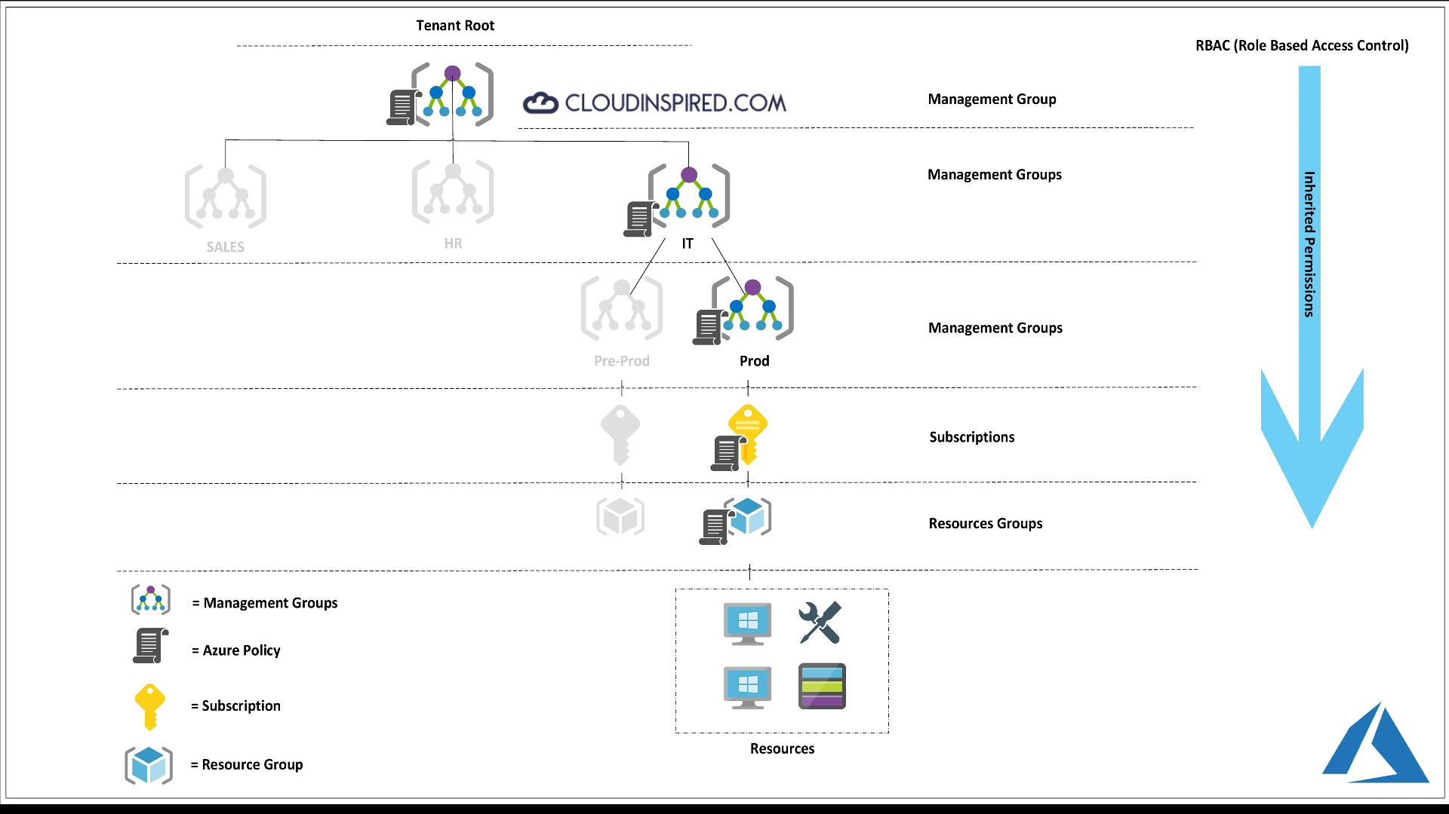
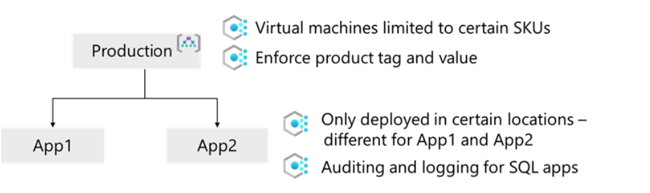
Azure Policy
Azure Policy is a service in Azure that enables you to create, assign, and manage policies to control or audit your resources. These policies enforce different rules over your resource configurations, so the configurations stay compliant with corporate standards.
Azure Policy lets you define both individual policies and groups of related policies, called initiatives.
Azure Policy comes with many built-in policy and initiative definitions.
Azure policies are inherited down the hierarchy.
You can scope and enforce Azure policies at different levels in the organizational hierarchy.
Azure Policy evaluates all resources in Azure and Arc-enabled resources (specific resource types that are hosted outside of Azure).
Azure Policy highlights resources that aren't compliant with the current policies.
Use Azure Policy to prevent noncompliant resources from being created, and automatically remediate noncompliant resources.
Azure Policy integrates with Azure DevOps by applying pre-deployment and post-deployment policies.

Slide 8
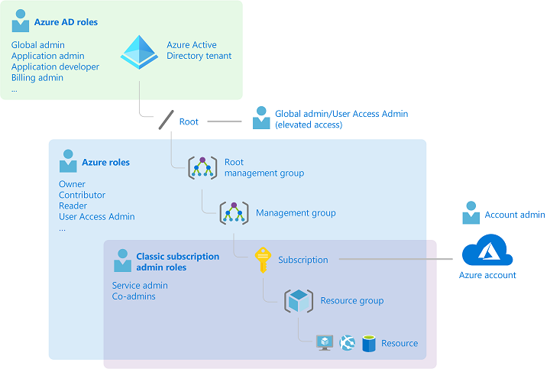
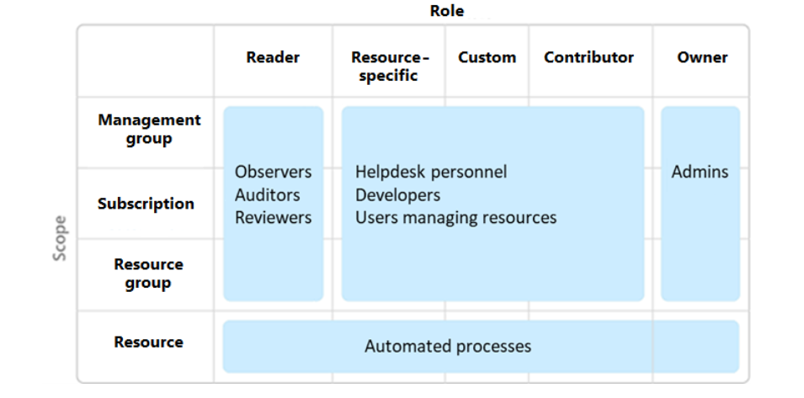
Role Based Access Control (RBAC)
Azure RBAC allows you to grant access to Azure resources that you control.
Azure RBAC evaluates each request for access and determines if access should
be blocked, not allowed, or allowed.
Allow one user to manage virtual machines in a subscription and allow
another user to manage virtual networks.
Allow members of a database administrator group to manage SQL databases in a subscription.
Allow a user to manage all resources in a resource group, such as virtual machines, websites, and subnets.
Allow an application to access all resources in a resource group.
Things to consider when using Azure RBAC
Consider the highest scope level for each requirement
Consider the access needs for each user
Consider assigning roles to groups, and not users
Consider when to use Azure policies

Slide 9

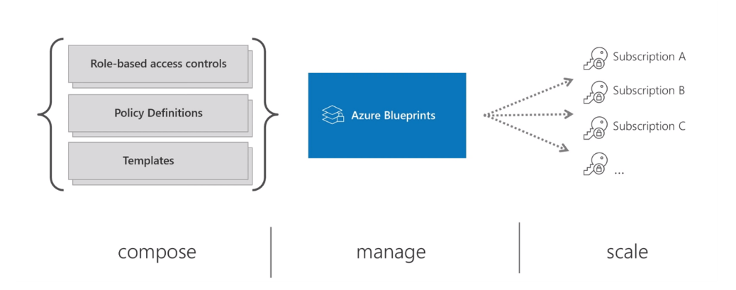
Azure Blueprint
Azure Blueprints lets you define a repeatable set of governance tools and standard Azure resources that your organization requires.
A blueprint is a package related to the implementation of Azure cloud services, security, and design. A blueprint can be reused to maintain consistency and compliance.
Azure Blueprints can be used to scale governance practices throughout an organization.
Azure Blueprints orchestrates the deployment of various resource templates and other artifacts.
With Azure Blueprints, the relationship between the blueprint definition (what should be deployed) and the blueprint assignment (what was deployed) is preserved.
Azure creates a record that associates a resource with the blueprint that defines it. This connection helps you track and audit your deployments.

Slide 10

Module -2 Design Identity
06/25/2023

Slide 11
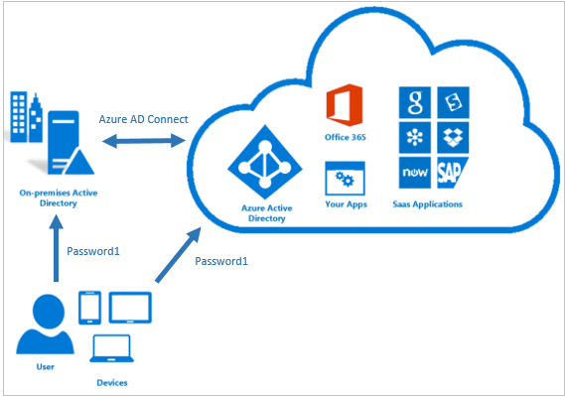
Identity & Access Management
To implement authentication and authorization, Azure Architects design identity and access management (IAM) solutions. These solutions must work for all users, applications, and devices. A strong IAM solution should have :
Unified identity management.
Seamless user experience
Secure adaptive access
Simplified identity governance

Slide 12

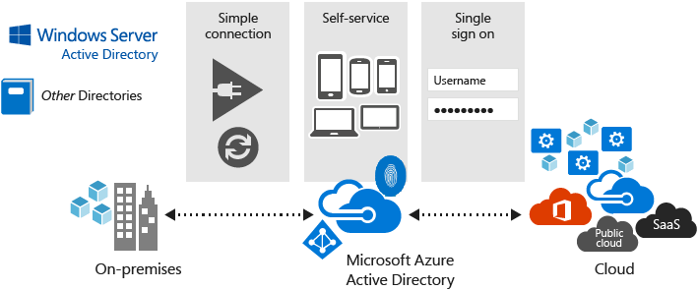
Azure Active Directory
Azure AD is the Azure solution for identity and access management. Azure Active Directory is :
Cloud Based Directory
Multitenant
Identity Management Service
Things to Know when using Azure AD
The cloud-only identity solution provides both identity management and protection for your accounts, including role-based access control (RBAC), conditional access, and access reviews..
Azure AD also offers a hybrid identity solution for identity management
In hybrid environments, Azure AD extends on-premises Active Directory to the cloud.
With Azure AD Connect or Azure AD Connect cloud sync, you can bring on-premises identities into Azure AD. After the on-premises accounts are in Azure AD, they'll get the benefits of easy management and identity protection
Provide single sign-on access to applications and infrastructure services.
Enhance security with additional factors of authentication
Empower your users to complete password resets themselves, as well as request access to specific apps and services.

Slide 13
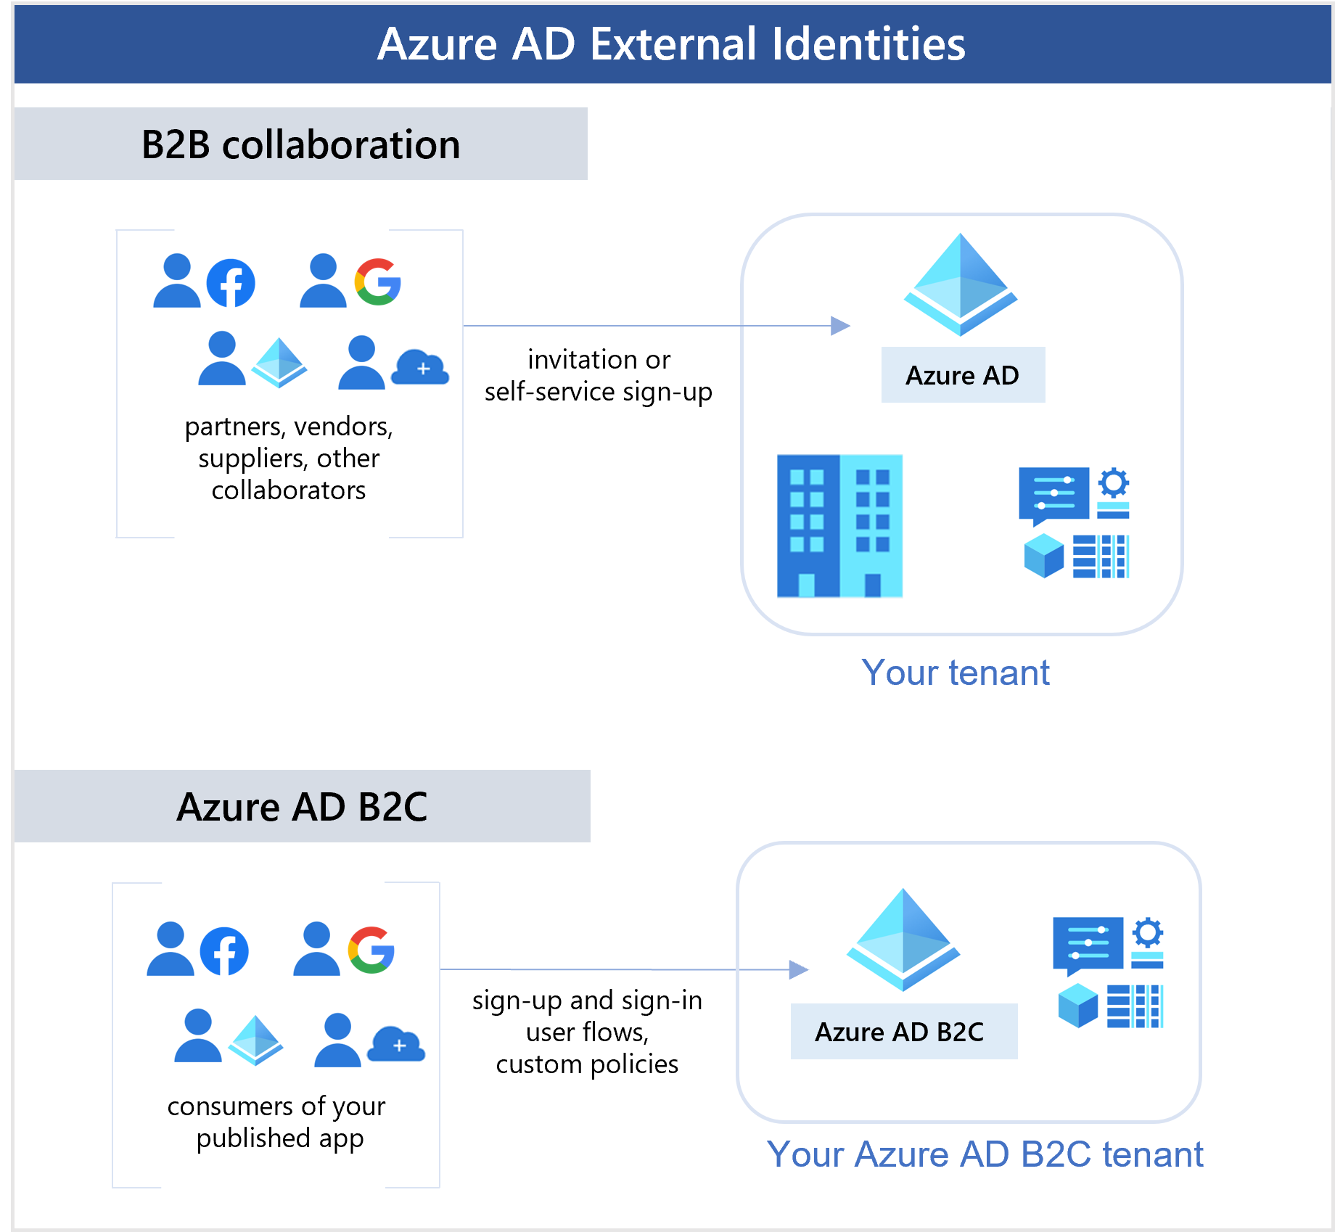
External Identities in Azure Active Directory
With External Identities, external users can "bring their own identities." Whether they have a corporate or government-issued digital identity, or an unmanaged social identity like Google or Facebook
The following capabilities make up External Identities:
B2B collaboration - Collaborate with external users by letting them use their preferred identity to sign into your Microsoft applications or other enterprise applications (SaaS apps, custom-developed apps, etc.). B2B collaboration users are represented in your directory, typically as guest users.
B2B direct connect - Establish a mutual, two-way trust with another Azure AD organization for seamless collaboration. B2B direct connect currently supports Teams shared channels
Azure AD B2C - Publish modern SaaS apps or custom-developed apps (excluding Microsoft apps) to consumers and customers, while using Azure AD B2C for identity and access management.

Slide 14
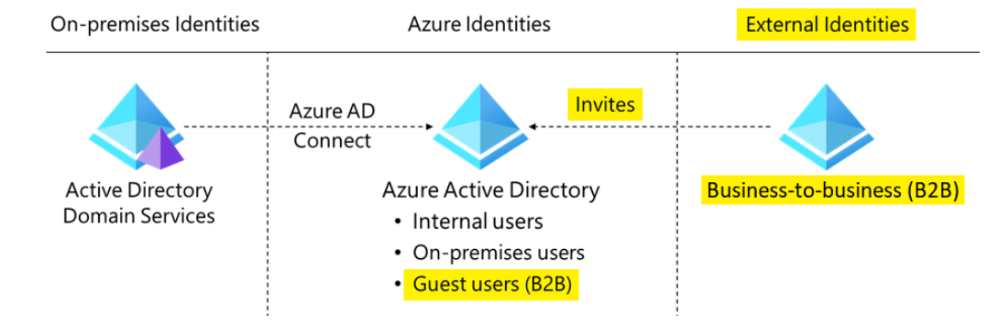
Azure Active Directory Business-to-Business
With B2B collaboration, you can invite anyone to sign into your Azure AD organization using their own credentials so they can access the apps and resources you want to share with them
Things to Know when using Azure AD B2B
With Azure AD B2B, the external partner uses their own identity management solution. Organization doesn't need to manage the external accounts or passwords.
Organization doesn't need to sync the external accounts or manage the account lifecycles.
The identities are managed by the partner themselves, or by another external identity provider on their behalf.
Use B2B collaboration when you need to let external users access your Office 365 apps, software-as-a-service (SaaS) apps, and line-of-business application
There are various ways to add external users to your organization for B2B collaboration:
Invite users to B2B collaboration using their Azure AD accounts, Microsoft accounts, or social identities that you enable, such as Google
Use self-service sign-up user flows to let external users sign up for applications themselves. The experience can be customized to allow sign-up with a work, school, or social identity (like Google or Facebook)
use cross-tenant access settings to manage B2B collaboration with other Azure AD organizations and across Microsoft Azure clouds.

Slide 15

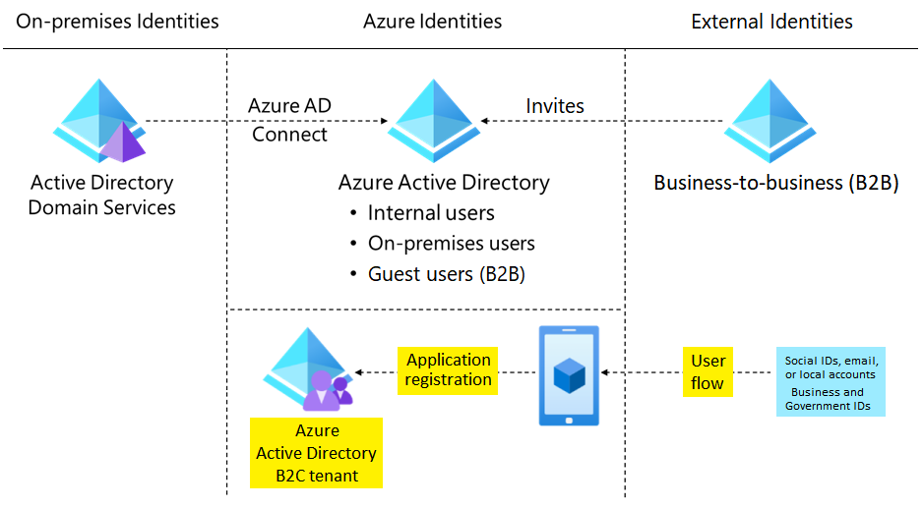
Azure Active Directory Business-to-Customer
Azure AD B2C is a type of Azure AD tenant for managing customer identities and their access to your apps. Azure AD B2C requires an Azure AD tenant, but this tenant isn't the same as the Azure AD tenant for your organization.
With Azure AD B2C, customers can sign in with an identity they've already established (like Facebook or Gmail). You can completely customize and control how customers sign up, sign in, and manage their profiles when using your applications.
Azure AD B2C provides secure authentication for your customers by using their preferred identity providers.
You can capture sign in, preference, and conversion data for your customers.
Azure AD B2C stores custom attributes about customers so you can use the information in your apps.
You can use branded registration and custom UI sign-in experiences.
The B2C option lets you separate the organization account from the customer account.

Slide 16
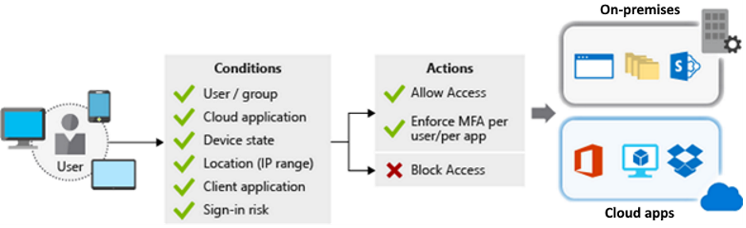
Conditional Access
Conditional Access is a feature that Azure Active Directory uses to allow (or deny) access to resources. When a user signs in, Conditional Access examines who the user is, where the user is, and from what device the user is requesting access. Based on these signals, Conditional Access can allow access, enforce multifactor authentication (MFA), or deny access.
Things to know about Conditional Access
MFA supports granular control. You can use MFA selectively and require it for certain users only.
Azure AD allows named locations to be used with app policies to control access.
Service access can be restricted through approved client apps only.
Access to apps can be limited to managed devices that meet your security and compliance standards.
Untrusted sources can be blocked, such as sources from an unknown or unexpected location.
Report-only mode helps admins evaluate the impact of Conditional Access policies before enabling them in their environment.
The What If tool helps you plan and troubleshoot Conditional Access policies.
To use Conditional Access, you need an Azure AD Premium P1 or P2 license. If you have a Microsoft 365 Business Premium license, you also have access to Conditional Access features.

Slide 17
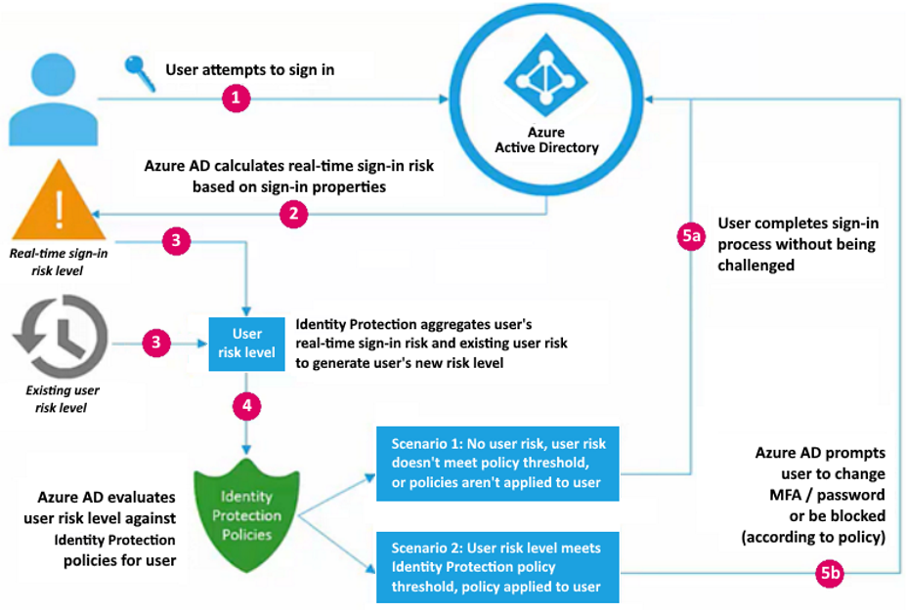
Identity Protection
Identity Protection is a tool that allows organizations to accomplish three key tasks:
Automate the detection and remediation of identity-based risks.
Investigate risks by using data in the Azure portal.
Export risk detection data to other tools.
Identity Protection provides risk policy detection that includes any identified suspicious actions related to user accounts in the directory.
Two risk policies are evaluated: user risk and sign-in risk:
User risk represents the probability that a given identity or account is compromised
Eg- Leaked credentials, Azure AD threat Intelligence
Sign-in risk represents the probability that a given sign-in (authentication request) isn't authorized by the identity owner
Anonymous IP address
Atypical travel

Slide 18
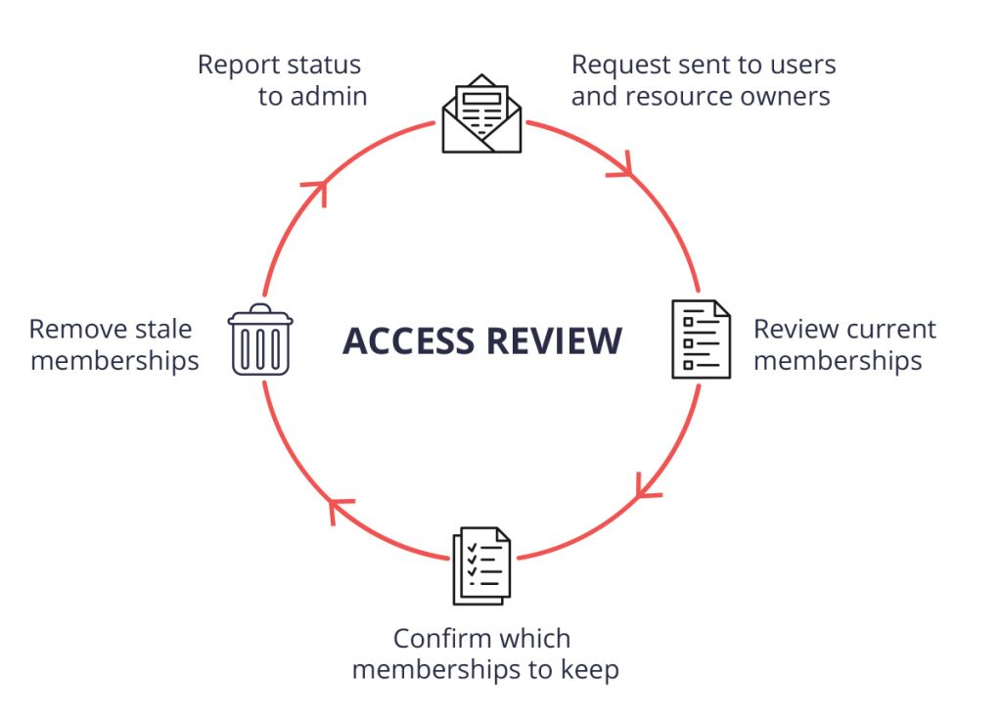
Access Reviews
Things to know to determine the purpose of the Azure AD access review
While you consider how to use Azure AD access reviews for Enterprises, think about the following characteristics of an access review.
Access reviews mitigate risk by protecting, monitoring, and auditing access to critical assets.
You use access reviews to help ensure the correct users have the correct access to the correct resources.
Confirm correct user access to apps integrated with Azure AD for single sign-on, including SaaS apps and line-of-business apps.
Verify group memberships that are synchronized to Azure AD, or created in Azure AD or Microsoft 365, including Microsoft Teams.
Check access packages that group resources (groups, apps, and sites) into a single package to manage access.
Access reviews can also be used for Azure AD roles and Azure Resource roles as defined.
Determine who will conduct the access reviews
Access reviews are only as good as the person doing the reviewing. Selecting good reviewers is critical to your success. The creator of the access review decides who will conduct the review. This setting can't be changed after the review is started. There are three types of reviewers:
Resource owners: The business owners of a resource.
Delegates: A group of individuals selected by the access reviews admin.
End user: A user who self-attests to their need for continued access.

Slide 19
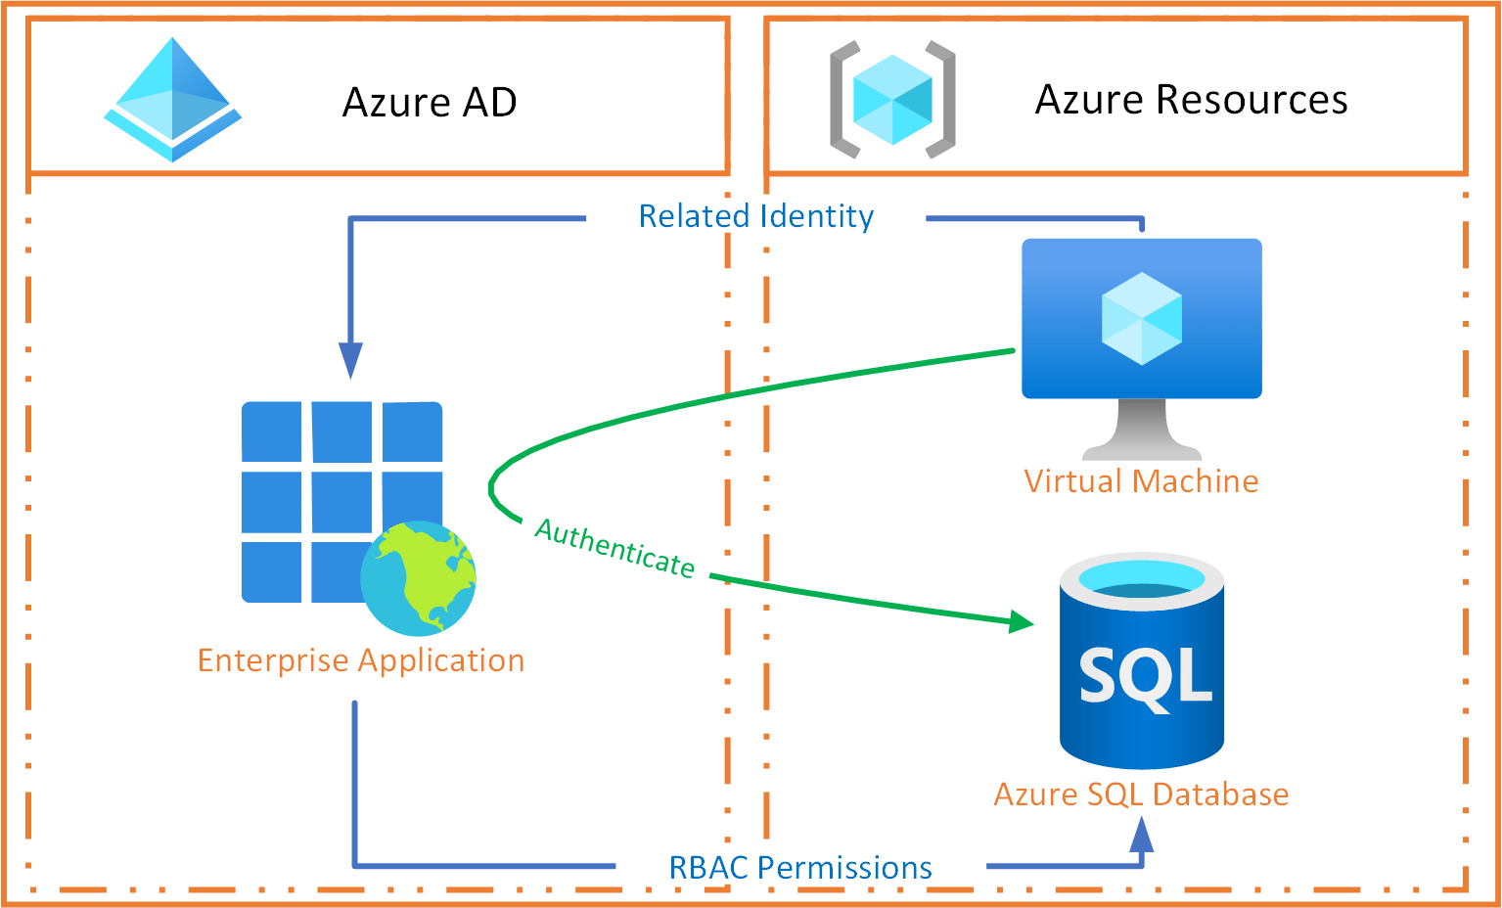
Managed Identities
Azure managed identity is a feature of Azure Active Directory that you can use free of charge. This feature automatically creates identities to allow apps to authenticate with Azure resources and services
There are two types of managed identities:
System-assigned: Some Azure services allow you to enable a managed identity directly on a service instance. When you enable a system-assigned managed identity, an identity is created in Azure AD that's tied to the lifecycle of that service instance. When the resource is deleted, Azure automatically deletes the identity. By design, only that Azure resource can use that identity to request tokens from Azure AD.
User-assigned: You can create a managed identity as a standalone Azure resource. Create a user-assigned managed identity and assign it to one or more instances of an Azure service. A user-assigned identity is managed separately from the resources that use it.
A managed identity combines Azure AD authentication and Azure role-based access control (RBAC).
When you use managed identities, you don't need to rotate credentials or worry about expiring certifications. Azure handles credential rotation and expiration in the background. To configure an app to use a managed identity, you use the provided token to call the service.
Resources that support system-assigned managed identities allow you to:
Enable or disable managed identities at the resource level.
Use RBAC roles to grant permissions.
Review create, read, update, delete (CRUD) operations in Azure Activity logs.
Review sign-in activity in Azure AD sign-in logs.
Managed identities can be enabled or disabled on an app at any time.

Slide 20
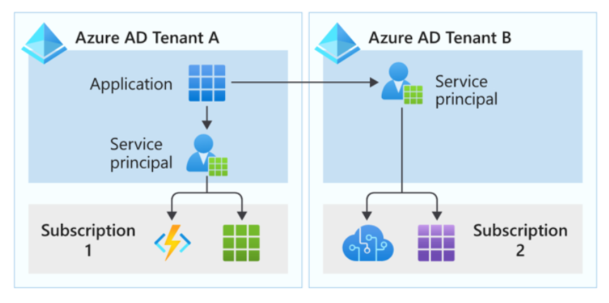
Service Principals For Applications
When a user or application requests access to a resource that's secured by an Azure Active Directory tenant, the user or app must be represented by a security principal. The security principal defines the access policy and permissions for the user (user principal) or app (service principal) in the Azure AD tenant. The principal supports core features like authentication for a user and app during sign-in, or authorization during resource access.

Slide 21
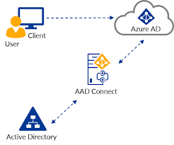
Azure AD Connect
Azure AD Connect is an on-premises Microsoft application that's designed to meet and accomplish your hybrid identity goals
Azure AD Connect features
Password hash synchronization - A sign-in method that synchronizes a hash of a users on-premises AD password with Azure AD.
Pass-through authentication - A sign-in method that allows users to use the same password on-premises and in the cloud, but doesn't require the additional infrastructure of a federated environment.
Federation integration - Federation is an optional part of Azure AD Connect and can be used to configure a hybrid environment using an on-premises AD FS infrastructure. It also provides AD FS management capabilities such as certificate renewal and additional AD FS server deployments.
Synchronization - Responsible for creating users, groups, and other objects. As well as, making sure identity information for your on-premises users and groups is matching the cloud. This synchronization also includes password hashes.
Health Monitoring - Azure AD Connect Health can provide robust monitoring and provide a central location in the Azure portal to view this activity.

Slide 22
Design Authentication
Cloud Authentication
Federated
Authentication
Cloud Only
AD FS
Password Hash Synchronization
+ Seamless SSO
3rd Party Federation Provider
Passthrough Authentication
+ Seamless SSO

Slide 23
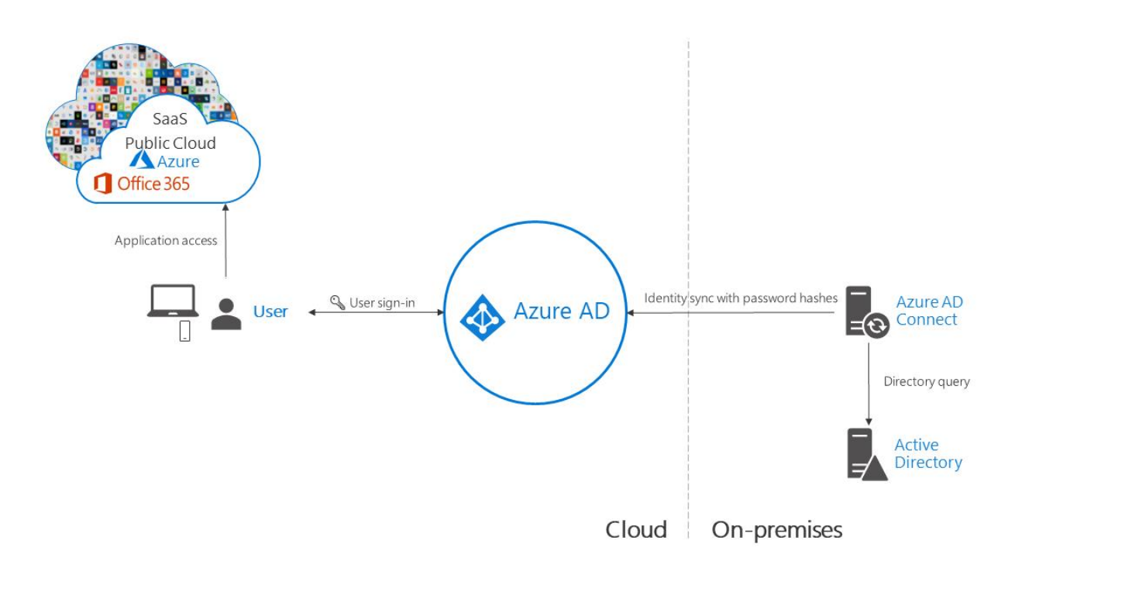
Password Hash Synchronization

Slide 24
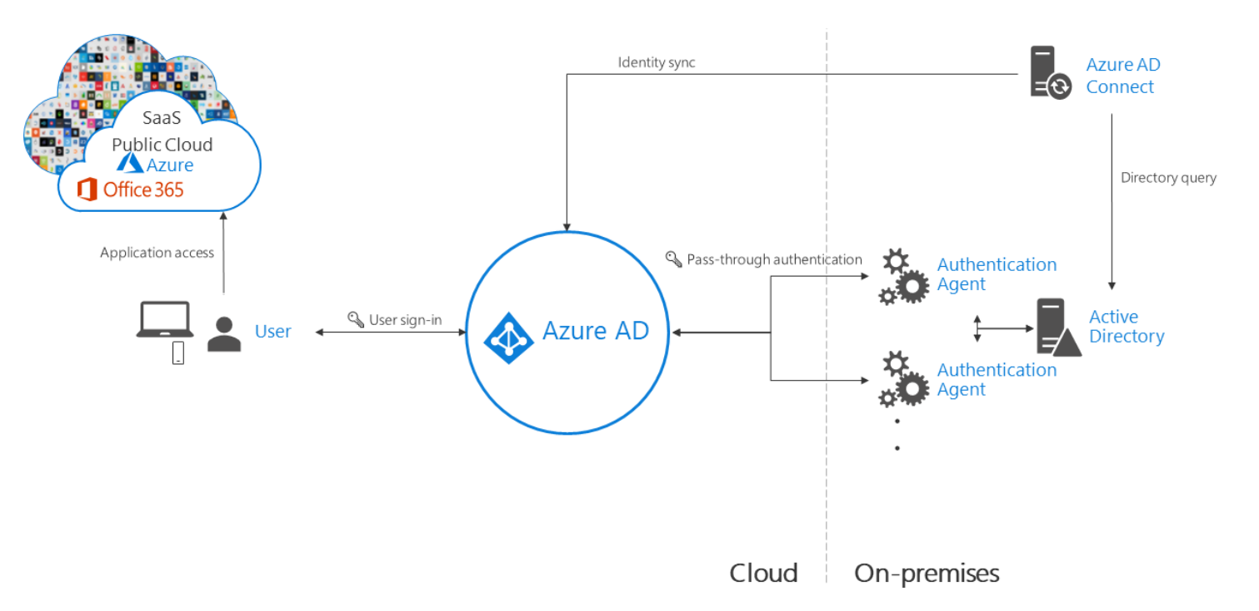
Passthrough Authentication
Need 1 or more (recommend 3) agents installed on existing servers.
Must have access to on-premises AD controllers.
Need outbound access to internet
For Business Continuity - Deploy password hash sync as a backup method
Remember passthrough auth enforces on the on-premises account
policy at the time of sign i

Slide 25
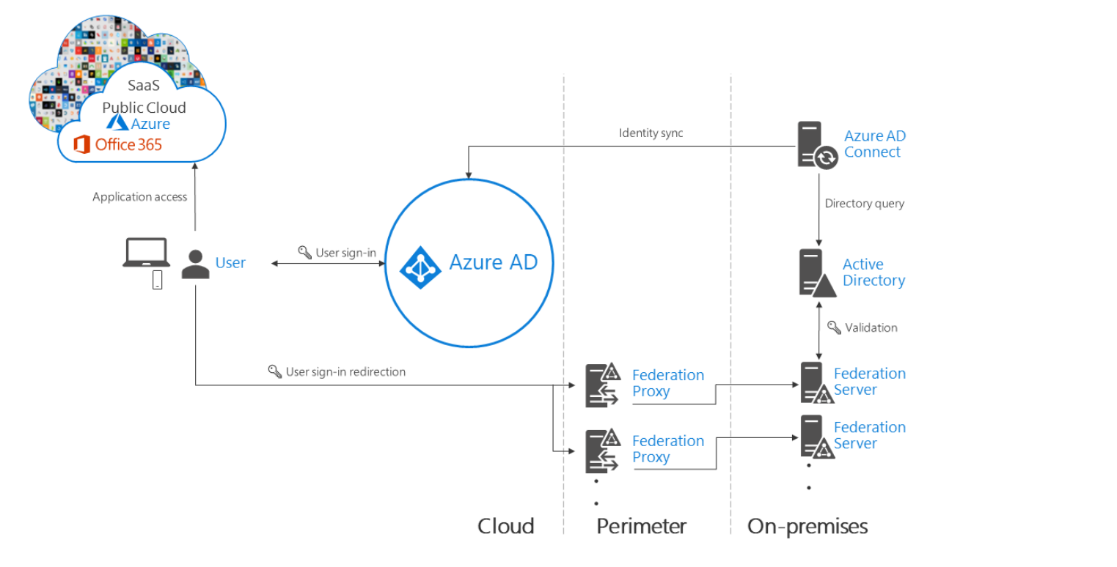
Federated Authentication

Slide 26
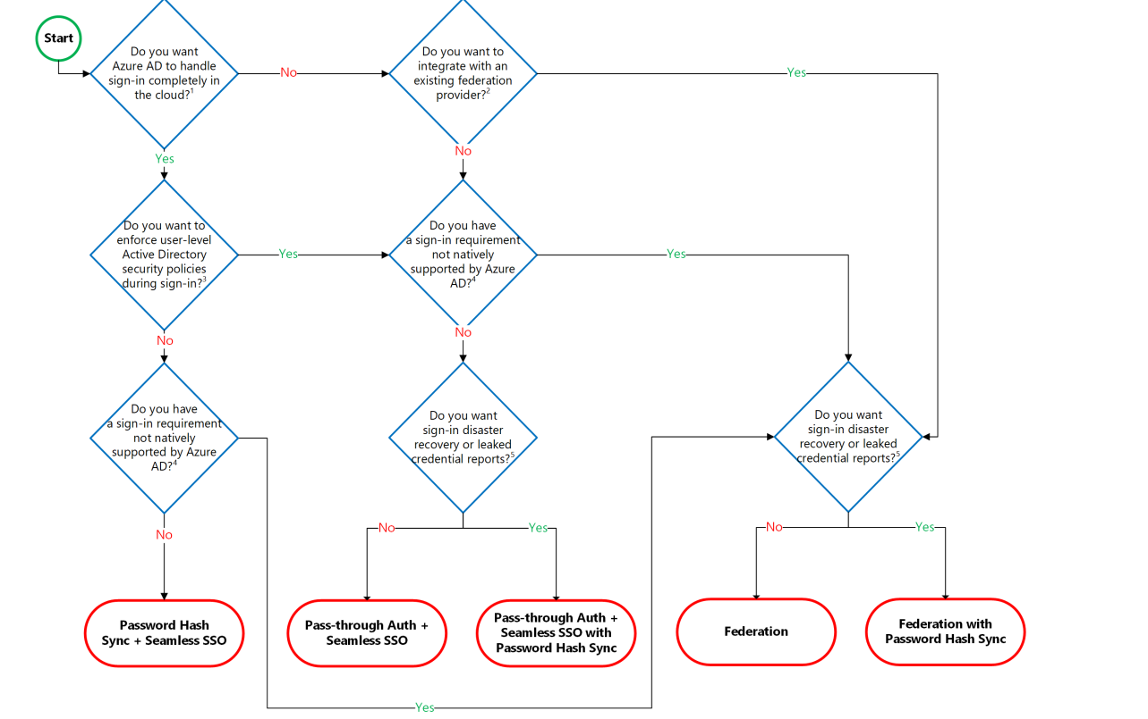
Authentication service decision flowchart

Slide 27


Module -3 Design Infrastructure Solution
06/25/2023

Slide 28
Azure Compute Services
Azure Virtual Machines: Deploy and manage virtual machines inside an Azure virtual network.
Azure Batch: Apply this managed service to run large-scale parallel and high-performance computing (HPC) applications.
Azure App Service: Host web apps, mobile app backends, RESTful APIs, or automated business processes with this managed service.
Azure Functions: Use this managed service to run code in the cloud, without worrying about the infrastructure.
Azure Logic Apps: Configure this cloud-based platform to create and run automated workflows similar to capabilities in Azure Functions.
Azure Container Instances: Run containers in Azure in a fast and simple manner without creating virtual machines or relying on a higher-level service.
Azure Kubernetes Service (AKS): Run containerized applications with this managed Kubernetes service.

Slide 29

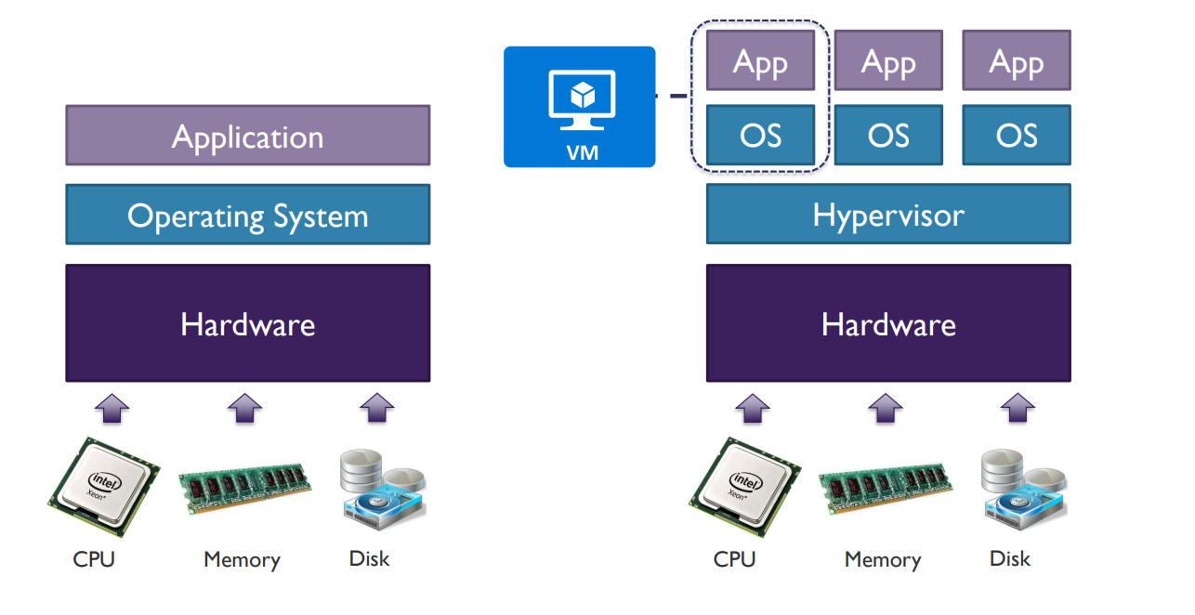
Azure Virtual Machines solutions
Azure Virtual Machines is the basis of the Azure Infrastructure-as-a-Service (IaaS) model. Virtual Machines can be used for developing, testing, and deploying applications in the cloud, or to extend your datacenter. Virtual Machines offers a fast, scalable, flexible way to add more compute power to your enterprise.

Slide 30
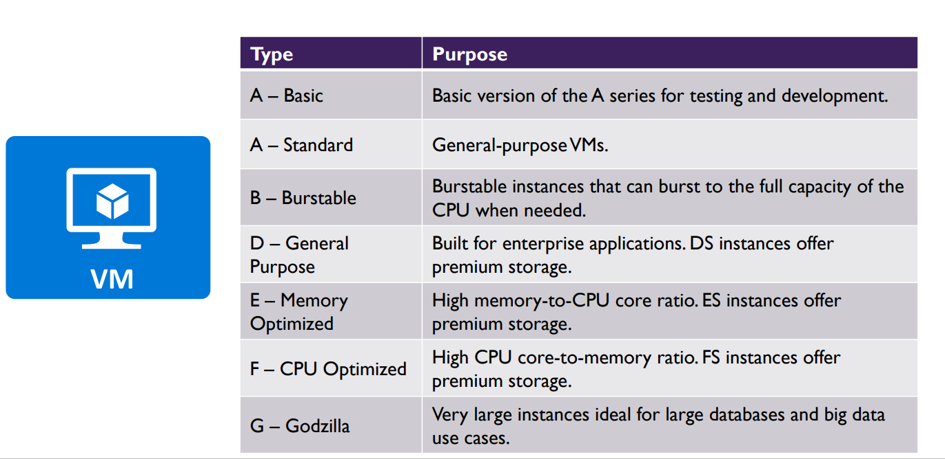
VM Types

Slide 31
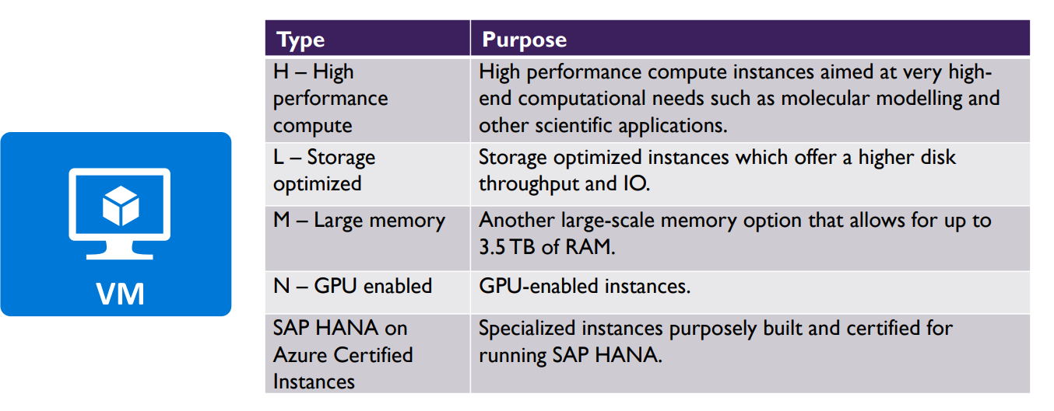
VM Type (Cont.)

Slide 32
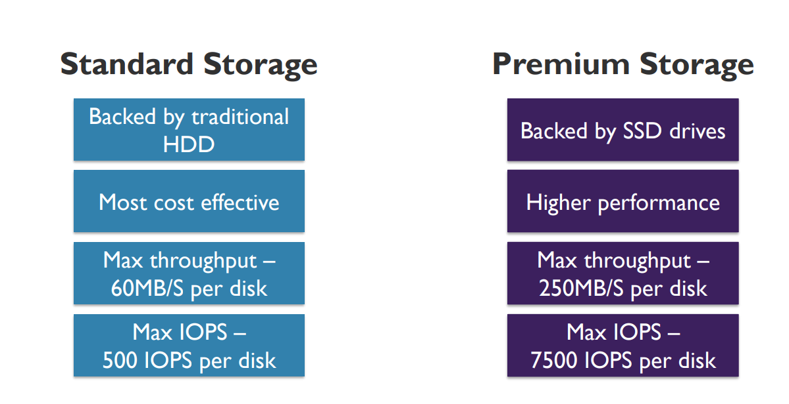
VM Storage Types

Slide 33
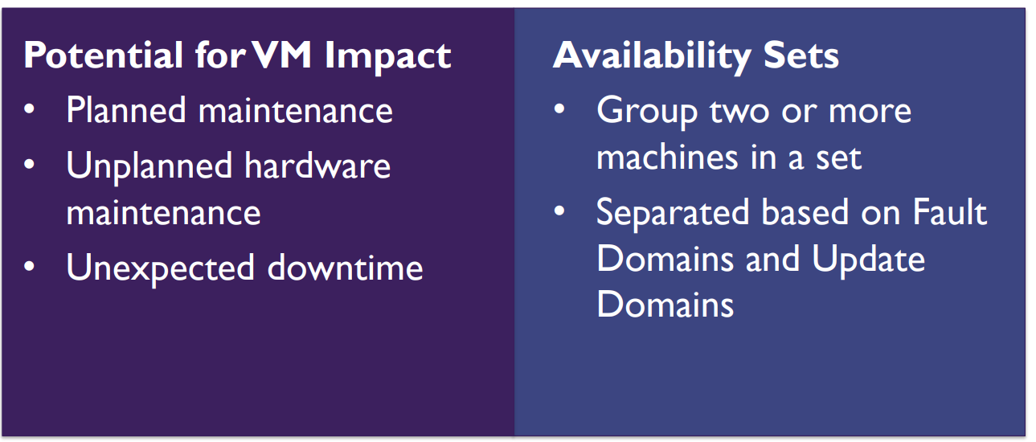
Availability Set

Slide 34
Azure Batch
Nodes are used in the Azure Batch account to run the applications that would process your workloads.
Azure Batch The nodes are run in a pool that are defined in the Azure Batch account.
Scripts or executables can run on the nodes.
Executables or scripts include *.exe, *.cmd, *.bat, and PowerShell scripts (for Windows) and binaries, shell, and Python scripts (for Linux).
You can have two types of nodes Azure Batch
Dedicated nodes – These are reserved nodes that can guarantee that the jobs will run on the nodes.
Low-priority nodes – These are less expensive , but they depend on the surplus capacity that is available in Azure

Slide 35
Azure App Service
Create and Configure Azure App Service
Azure App Service is an HTTP-based service for hosting web applications, REST APIs, and mobile back ends. You can develop in your favorite language, be it .NET, .NET Core, Java, Ruby, Node.js, PHP, or Python. Applications run and scale with ease on both Windows and Linux-based environments.
App Service not only adds the power of Microsoft Azure to your application, such as security, load balancing, autoscaling, and automated management. App Service also supports custom domains, and TLS/SSL certificates.
With App Service, you pay for the Azure compute resources you use. The compute resources
Things to consider when using Azure App Service
Create web apps with App Service by using ASP.NET, ASP.NET Core, Java, Ruby, Node.js, PHP, or Python. You can choose either Windows or Linux as the host operating system.
Build API apps similar to REST-based web APIs with your choice of language and framework. Azure App Service offers full Swagger support, and the ability to package and publish your API in Azure Marketplace
Use the App Service WebJobs feature to run a program or script. Program examples include Java, PHP, Python, or Node.js. Script examples include cmd, bat, PowerShell, or Bash. WebJobs can be scheduled or run by a trigger. WebJobs are often used to run background tasks as part of your application logic.
Continuous Deployment
Authentication & Autherization

Slide 36
Azure App Service Plan
Subscription the plan belongs to
Location (e.g. North Central US, etc.)
Pricing tier (Free, Shared, Basic, Standard Premium, Isolated)
Instance size (Small, Medium, Large)
App Service Plan Pricing Tiers
Shared Compute Resources
Free
Shared
Basic
Standard
Premium
Isolated
Dedicated Compute Resources

Slide 37
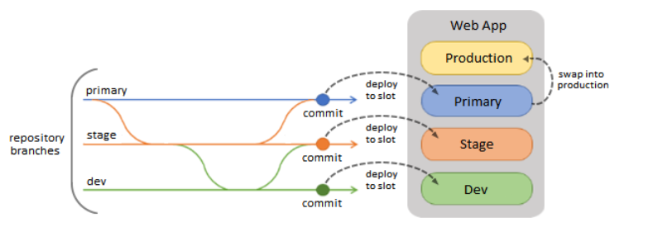
Deployment slots
Using the Azure portal, you can easily add deployment slots to an App Service web app. For instance, you can create a staging deployment slot where you can push your code to test on Azure. Once you are happy with your code, you can easily swap the staging deployment slot with the production slot. You do all this with a few simple mouse clicks in the Azure portal.

Slide 38
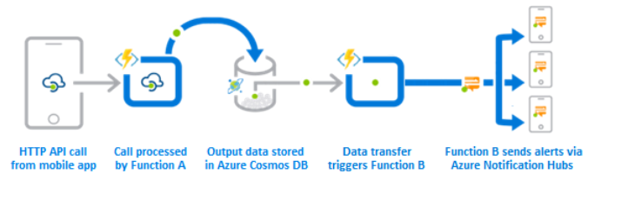
Azure Function
Azure Functions provides intrinsic scalability. You're charged only for the resources you use.
With Azure Functions, you can write your function code in the language of your choice.
Azure Functions supports compute on demand in two significant ways:
Azure Functions lets you implement your system's logic into readily available blocks of code. These code blocks (functions) can run anytime you need to respond to critical events.
As requests increase, Azure Functions meets the demand with as many resources and function instances as necessary. As requests complete, any extra resources and application instances drop off automatically.
Azure Functions is an ideal solution for handling specific definable actions triggered by an event. A function can process an API call and store the processed data in Azure Cosmos DB. After the data transfer happens, another function can trigger a notification.

Slide 39
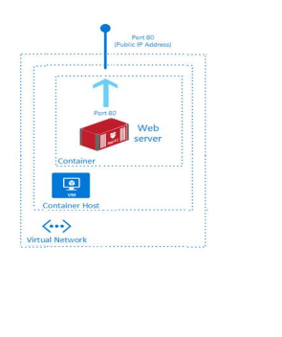
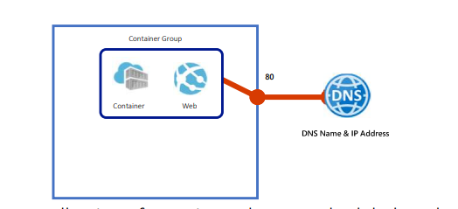
Azure Container Instance
Azure Container Instances offers many benefits, including fast startup, per second billing, and persistent storage. These benefits make Azure Container Instances a great compute solution to support new workloads and migrate data by using the lift and shift pattern.
Azure Container Instances enables fast startup. You can launch containers in seconds for immediate access to applications.
Azure Container Instances implements per second billing. You incur costs only while your container is running.
Azure Container Instances supports custom sizes for your containers. You can specify exact values for CPU cores and memory and avoid costs for unused resources.
Container Instances offers persistent storage. Azure Files shares can be mounted directly to a container to retrieve and persist state.
Container Instances can be used with Linux and Windows. Schedule both Windows and Linux containers using the same API.
collection of containers that get scheduled on the same host
The containers in the group share a lifecycle, resources, local network, and storage volumes
Azure Container Instance
Azure Container Group

Slide 40
Azure Kubernetes Services
Kubernetes is a portable, extensible open-source platform for automating deployment, scaling, and the management of containerized workloads. This orchestration platform provides the same ease of use and flexibility as with Platform as a Service (PaaS) and Infrastructure as a Service (IaaS) offerings. Kubernetes provides both container management and container orchestration.
Container management is the process of organizing, adding, removing, or updating a significant number of containers. Most of these tasks are manual and error prone. Container orchestration is a system that automatically deploys and manages containerized applications. The orchestrator can dynamically increase or decrease the deployed instances of the managed application. The orchestrator can also ensure all deployed container instances get updated if a new version of a service is released.
Azure Kubernetes Service (AKS) manages your hosted Kubernetes environment and makes it simple to deploy and manage containerized applications in Azure.
The Kubernetes cluster is managed by Azure and is free. You manage the agent nodes in the cluster and only pay for the virtual machines on which your nodes run.
When you create the cluster, you can use Azure Resource Manager (ARM) templates to automate cluster creation. With ARM templates, you specify features like as advanced networking, Azure Active Directory (AD) integration, and monitoring.
AKS gives you the benefits of open-source Kubernetes. You don't have the complexity or operational overhead of running your own custom Kubernetes cluster.

Slide 41
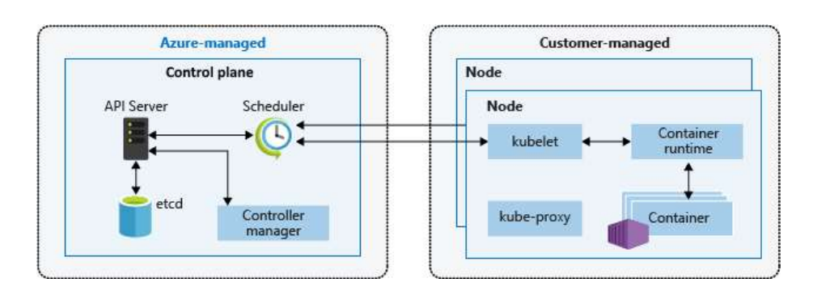
Kubernetes Cluster Architecture
kube-apiserver - The API server is how the underlying Kubernetes APIs are exposed. This component provides the interaction for management tools, such as the Kubernetes dashboard.
etcd - To maintain the state of your Kubernetes cluster and configuration, the highly available etcd is a key value store within Kubernetes.
kube-scheduler - When you create or scale applications, the Scheduler determines what nodes can run the workload and starts them.
kube-controller-manager - The Controller Manager oversees a number of smaller Controllers that perform actions such as replicating pods and handling node operations.

Slide 42
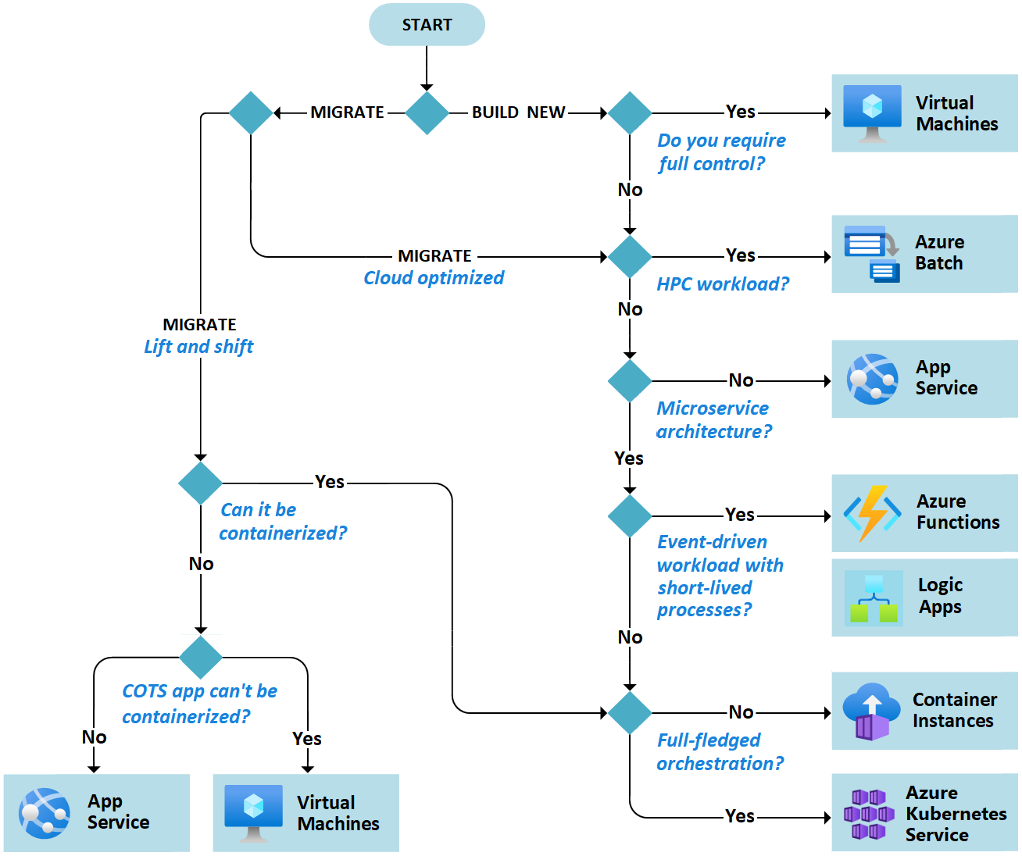
Azure compute service decision flowchart

Slide 43
Module -5 Microsoft Azure Well-Architected Framework
06/25/2023

Slide 44
Microsoft Azure Well-Architected Framework - Security
Security is one of the most important aspects of any architecture. Ensuring that your business data and customer data are secure is critical. A public data breach can ruin a company's reputation, as well as cause significant personal and financial harm.
Gone are the days when security focused solely on a strong perimeter defense to keep out malicious hackers. Anything outside the perimeter was treated as hostile, whereas inside the wall, an organization's systems were trusted. Today's security posture is to assume breach and use the Zero Trust model.
Security professionals no longer focus on perimeter defense. Modern organizations have to support access to data and services evenly from both inside and outside the corporate firewall

Slide 45
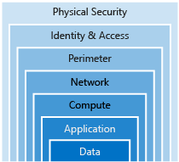
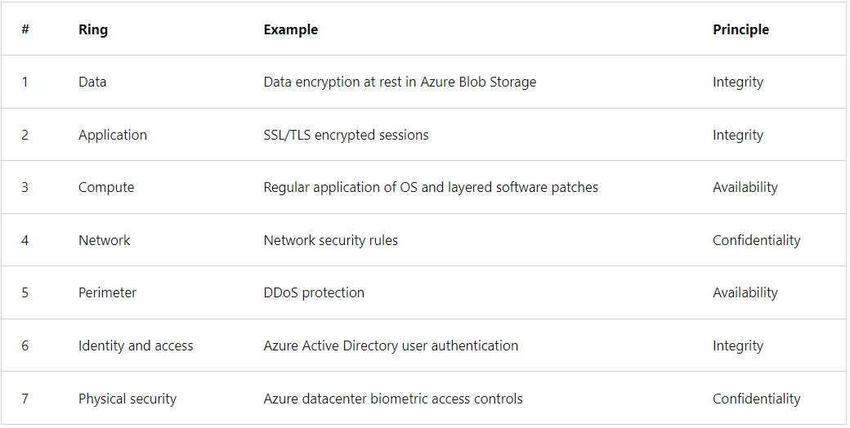
Defence in Depth

Slide 46
Identity as a layer of security
Digital identities are an integral part of today's business and social interactions on-premises and online. In the past, identity and access services were restricted to operating within a company's internal network. Protocols such as Kerberos and LDAP were designed for this purpose.
Provide single sign-on to application users
Enhance the application to use modern authentication with minimal effort
Enforce multifactor authentication for all sign-ins outside the company's network
Develop an application to allow patients to enroll and securely manage their account data

Slide 47
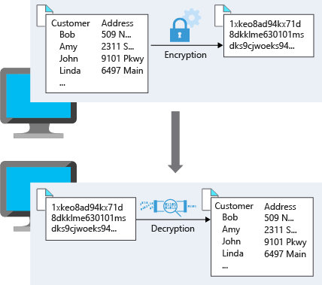
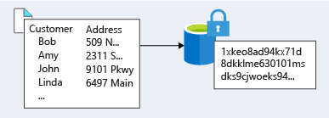
Encryption
Encryption is the process of making data unreadable and unusable. To use or read the encrypted data, it must be decrypted, which requires the use of a secret key. There are two top-level types of encryption: symmetric and asymmetric.
Symmetric encryption uses the same key to encrypt and decrypt the data. Consider a password manager application. You enter your passwords, and they're encrypted with your own personal key. (Your key is often derived from your master password.) When the data needs to be retrieved, the same key is used, and the data is decrypted.
Asymmetric encryption uses a public key and private key pair. Either key can encrypt but can't decrypt its own encrypted data. To decrypt, you need the paired key. Asymmetric encryption is used for things like TLS (used in HTTPS) and data signing
Encryption at rest
Encryption at transit

Slide 48
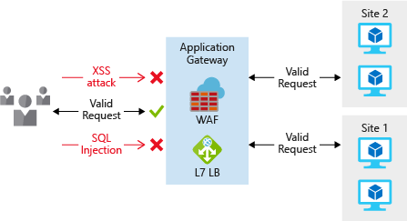
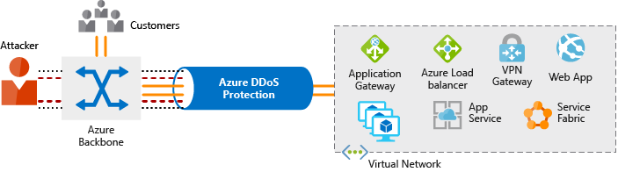
Network Security
Securing your network from attacks and unauthorized access is an important part of any architecture. As part of preparation for its cloud migration, your company took the time to plan its network infrastructure. The company wanted to ensure that it had network security controls in place to protect the network infrastructure from attack
Layered approach to network security
Internet protection

Slide 49
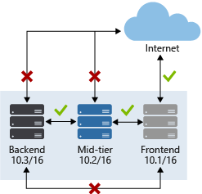
Network Security
Virtual network security

